Slide 1
Programming language types
Abdulrahman Abdelmoez Ahmed

Slide 2
Programming language
Low-level , High-level
Interpreted , Compiled
Programming , Scripted
Support OOP , Not supporting OOP

Slide 3

1-Low-Level Vs High-Level Languages -
Definitions
Languages used
Comparison

Slide 4
Definitions
Low-level language
High-level language
It is a low-level programming language that allows direct interaction with the CPU and gives the programmer control over hardware resources.
It is a high-level programming language that abstracts away hardware complexities and uses syntax similar to English, making it easier for humans to read and write.

Slide 5
Language used
Low level
High level
Assembly language
Machine code (0,1)
Python
JavaScript
Java
PHP

Slide 6
Comparison
Comparison | Far from hardware | Speed Response | Ease of writing | Memory control | Use cases
Low-level | Very close | fast | complex | Manual | Embedded sys OS developing
High level | So far | slower | Easy | Automatic | Web ,mobile app

Slide 7
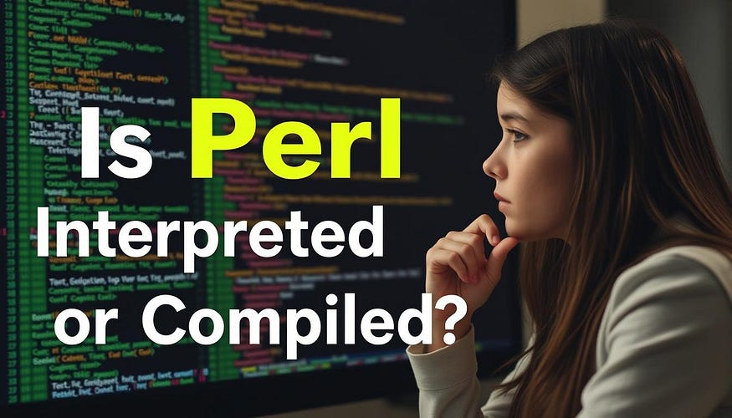
2- Interpreted Vs Compiled
Definition
Language used
Comparison

Slide 8
Definition
Interpreted
Compiled
Compiled
Interpreters run through a program line by line and execute each command. Here, if the author decides he wants to use a different kind of fruits , he could scratch the old one out and add the new one. Your translator friend can then convey that change to you as it happens.
Compiled languages are converted directly into machine code that the processor can execute. As a result, they tend to be faster and more efficient to execute than interpreted languages. They also give the developer more control over hardware aspects, like memory management and CPU usage.

Slide 9
Languages used
Interpreted
Compiled
Python
Java Script
PHP
C language
C++
GO

Slide 10
Comparison
Comparison | How it works | speed | Ease of editing | Final output
Interpreter | Code is executed line by line | Slow | Ease | No files
Compiled | The entire code is translated at once | Fast | More difficult | Executable file (.exe , .HEX)

Slide 11
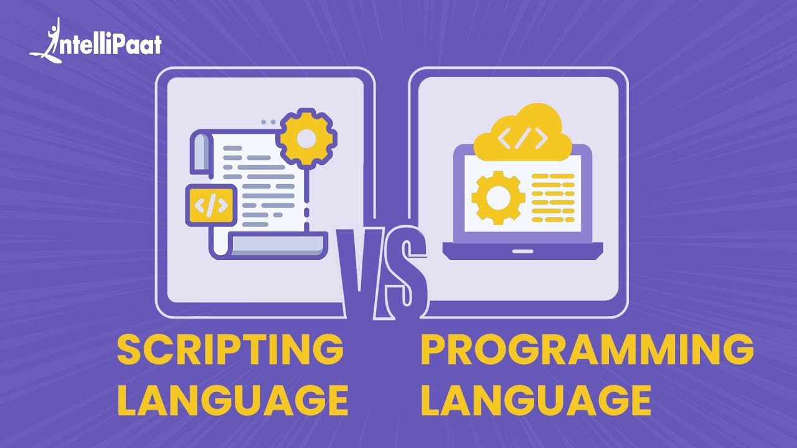
3- Programming Vs Scripting
Definition
Language used
Comparison

Slide 12
Definition
Programming
Scripting
A Programming language is a language which is used by humans to navigate their communication with computers.
A scripting language is a language that uses a naive method to bring codes to a runtime environment
Basically, all scripting languages are programming languages. The theoretical difference between the two is that scripting languages do not require the compilation step and are rather interpreted

Slide 13
Languages used
Programming
Scripted
Python
C++
C language
Python
PHP
JavaScript

Slide 14
Comparison
Comparison face | Purpose | Translation | Dependency | Files.exe
Programming | Build full app and sys | compiler | Self executable | Generate exe
Scripted | Performance small tasks or automation | Interpreted | Need to host | Do not create exe

Slide 15
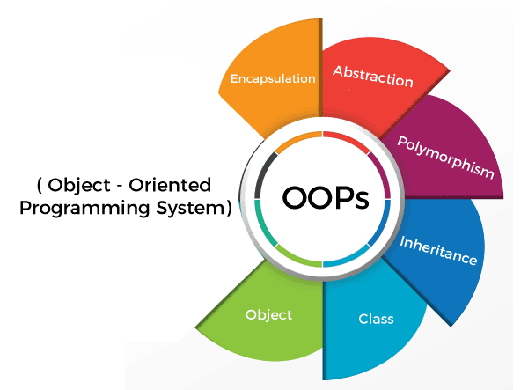
4 – OOP VS Not support OOP
Definition
Language used

Slide 16
Definition : Object-Oriented Programming
Object-oriented programming (OOP) is a computer programming model that organizes software design around data, or objects, rather than functions and logic. An object can be defined as a data field that has unique attributes and behavior.
We usually used to organize the code, reduced the error and make it easy to modified the code

Slide 17
Languages used
Not Supported
supported
SQL
Assembly
C language
Python
C++
Java

Slide 18
References
[1] ahttps://www.geeksforgeeks.org/software-engineering/what-is-a-low-level-language/
[2] https://www.freecodecamp.org/news/compiled-versus-interpreted-languages/
[3] https://www.geeksforgeeks.org/javascript/whats-the-difference-between-scripting-and-programming-languages/
[4] https://www.techtarget.com/searchapparchitecture/definition/object-oriented-programming-OOP

Slide 19


THANK YOU
LinkedIn
GitHub

